Slide 1
Explainable AI LIME Validation Technique Imbalanced Dataset

Slide 2
Explainable AI (XAI)
Explainable AI (XAI) helps explain an AI model’s decision-making process
Some of the most famous XAI techniques include SHAP (Shapley Additive exPlanations), DeepSHAP, DeepLIFT, CXplain, and LIME
Explainable AI methods, such as LIME, allow to explain and interpret the predictions of machine learning models
Interpretability means understanding why certain predictions are made by a model. Knowing these reasons increases the acceptance of and confidence in machine learning models
Explain individual predictions by showing how much each feature contributed to a given result

Slide 3
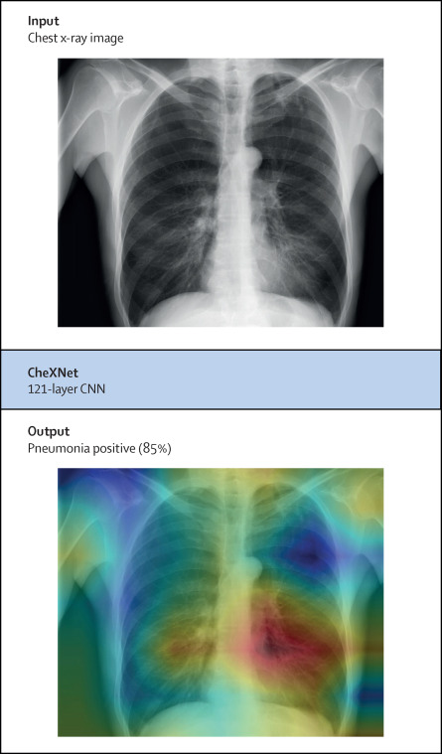
Explainable AI (XAI)
XAI can then help in medicine to detect disease using images.
Explainable Artificial Intelligence (XAI) tools quickly and easily highlight the areas in images that are crucial for classification, thus providing the attending doctor with significant support in making decisions
A ML model predicts with 70% accuracy that a patient has lung cancer. Though the model might have given the correct diagnosis, a doctor can’t really advise a patient confidently as he/she doesn’t know the reasoning behind the said model’s diagnosis

Slide 4
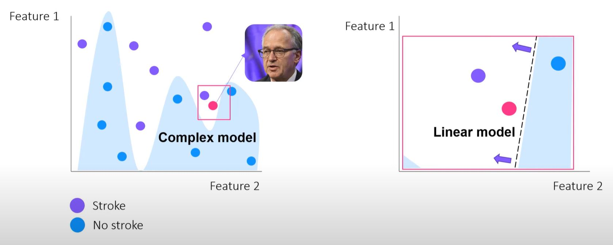
LIME XAI
Local Interpretable Model-agnostic Explanations (LIME)
Model agnosticism refers to the property of LIME using which it can give explanations for any given supervised learning model
Local explanations mean that LIME gives explanations that are locally faithful within the surroundings of the observation/sample being explained
LIME gives a local interpretable simpler linear surrogate model into the local area of a complex model

Slide 5
LIME XAI
Local Interpretable Model-agnostic Explanations (LIME)
Model agnosticism refers to the property of LIME using which it can give explanations for any given supervised learning model
Local explanations mean that LIME gives explanations that are locally faithful within the surroundings of the observation/sample being explained
LIME gives a local interpretable simpler linear surrogate model into the local area of a complex model
The method explains the
classifier for a specific single
instance and is therefore
suitable for local explanation

Slide 6
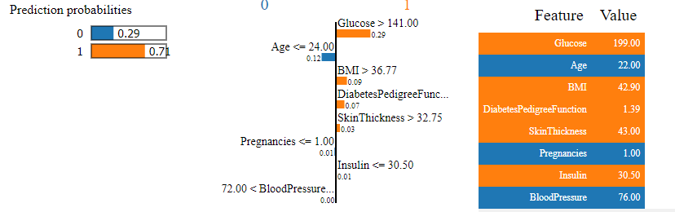
LIME XAI
LIME provides locally faithful explanations around the neighborhood of the instance being explained. By default, it considers 5000 samples(num_samples). Then it obtains the target variable for these 5000 samples using the prediction model, whose decisions it’s trying to explain.
Feature Selection from the surrogate dataset: After obtaining the surrogate dataset, it weighs each row according to how close they are to the original sample/observation. Then it uses a feature selection technique to obtain the top important features (Feature 2).
LIME also employs a Ridge Regression model on the samples using only the obtained features

Slide 7
Validation Technique
Essential to ensure that models perform well not just on the training data but also on new, unseen data.
Proper validation helps prevent overfitting, underfitting, and ensures that models generalize effectively
Hold-Out Validation/Train-test Split:
Most common validation technique: Simple and easy to implement
The data is split into two sets: a training set and a testing set. The model is trained on the training set and then evaluated on the test set.
Common Split Ratios: 70/30, 80/20, or 90/10 (training/test split).

Slide 8
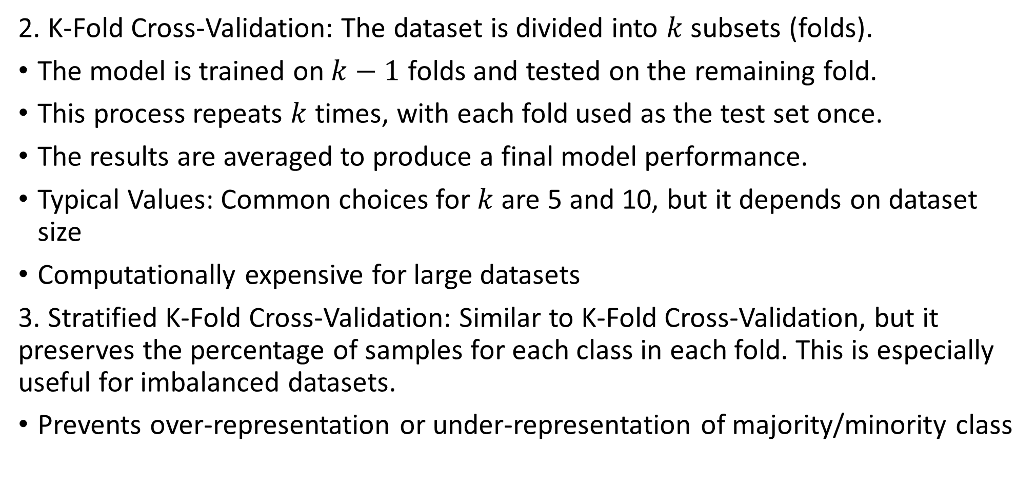
Various Validation Techniques
2. K-Fold Cross-Validation: The dataset is divided into $k$ subsets (folds).
The model is trained on $k−1$ folds and tested on the remaining fold.
This process repeats $k$ times, with each fold used as the test set once.
The results are averaged to produce a final model performance.
Typical Values: Common choices for $k$ are 5 and 10, but it depends on dataset size
Computationally expensive for large datasets
3. Stratified K-Fold Cross-Validation: Similar to K-Fold Cross-Validation, but it preserves the percentage of samples for each class in each fold. This is especially useful for imbalanced datasets.
Prevents over-representation or under-representation of majority/minority class

Slide 9
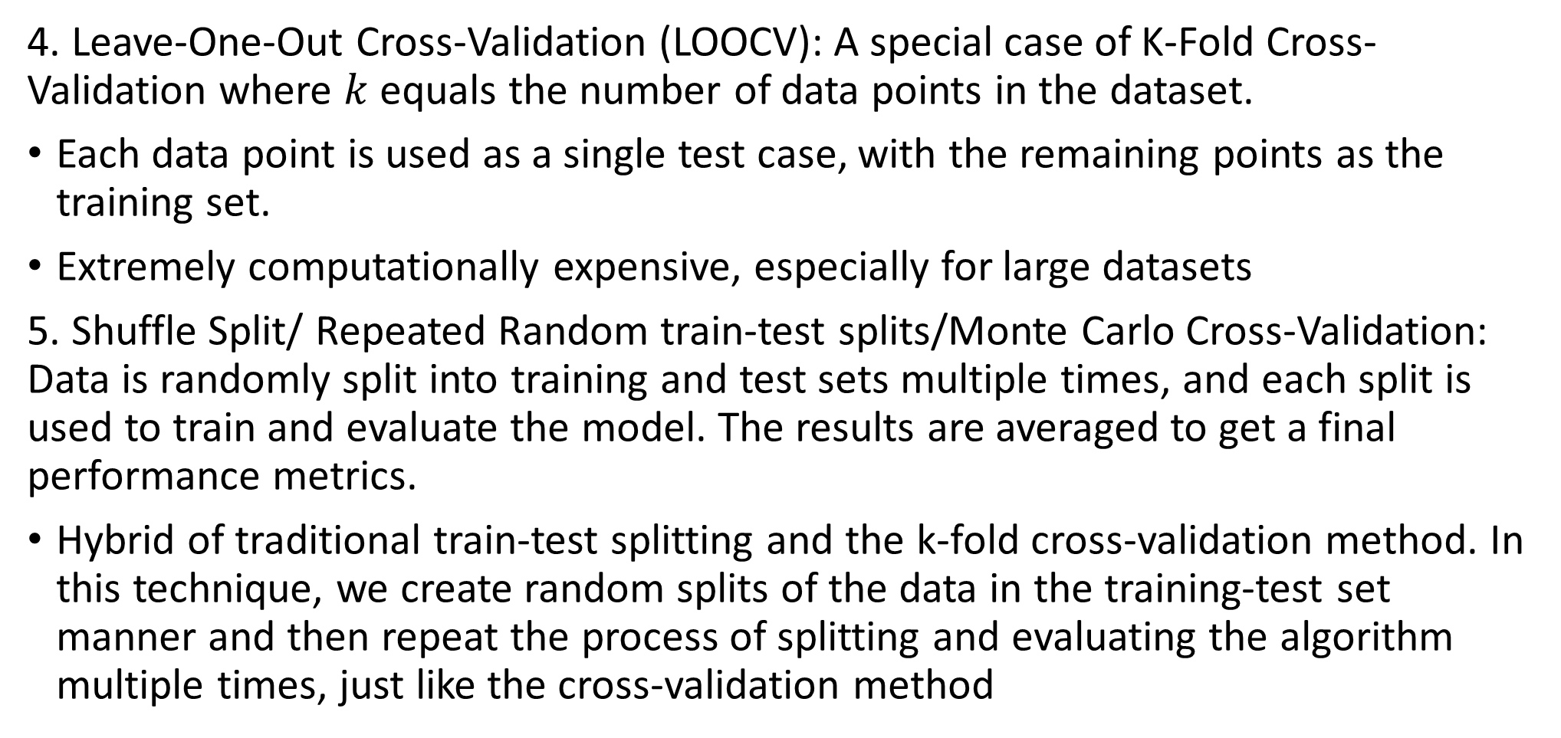
Various Validation Techniques
4. Leave-One-Out Cross-Validation (LOOCV): A special case of K-Fold Cross-Validation where $k$ equals the number of data points in the dataset.
Each data point is used as a single test case, with the remaining points as the training set.
Extremely computationally expensive, especially for large datasets
5. Shuffle Split/ Repeated Random train-test splits/Monte Carlo Cross-Validation: Data is randomly split into training and test sets multiple times, and each split is used to train and evaluate the model. The results are averaged to get a final performance metrics.
Hybrid of traditional train-test splitting and the k-fold cross-validation method. In this technique, we create random splits of the data in the training-test set manner and then repeat the process of splitting and evaluating the algorithm multiple times, just like the cross-validation method

Slide 10
Introduction to Imbalanced Datasets
Definition: An imbalanced dataset occurs when one class significantly outnumbers the other(s) in a classification task.
Example: Fraud detection, where fraudulent transactions are far fewer than legitimate ones.
Why It's a Problem: Imbalance can lead to biased models that perform poorly on the minority class, often the class of primary interest.
The majority class is the class with the highest number of samples
The minority class is the class with the lowest number of samples
Models tend to focus on the majority class.
Metrics like accuracy can be misleading (e.g., 90% accuracy could mean just predicting the majority class).

Slide 11
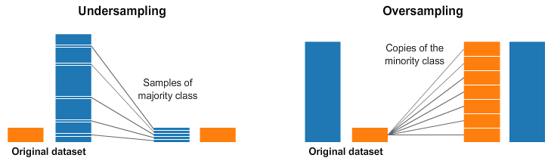
Tackle Imbalanced Datasets
1. Random Under-Sampling: Arguably the most common sampling approach, the Random Under-Sampler performs a downsampling of the larger/majority classes in the simplest way possible – randomly removes available instances from majority class.
2. Over-Sampling: An alternative to RU, the Random Over-Sampler algorithm follows a similar technique in the opposite direction – as opposed to downsampling larger classes, smaller/minority classes are oversampled until the class sizes are balanced. With oversampling, instances appear multiple times.

Slide 12
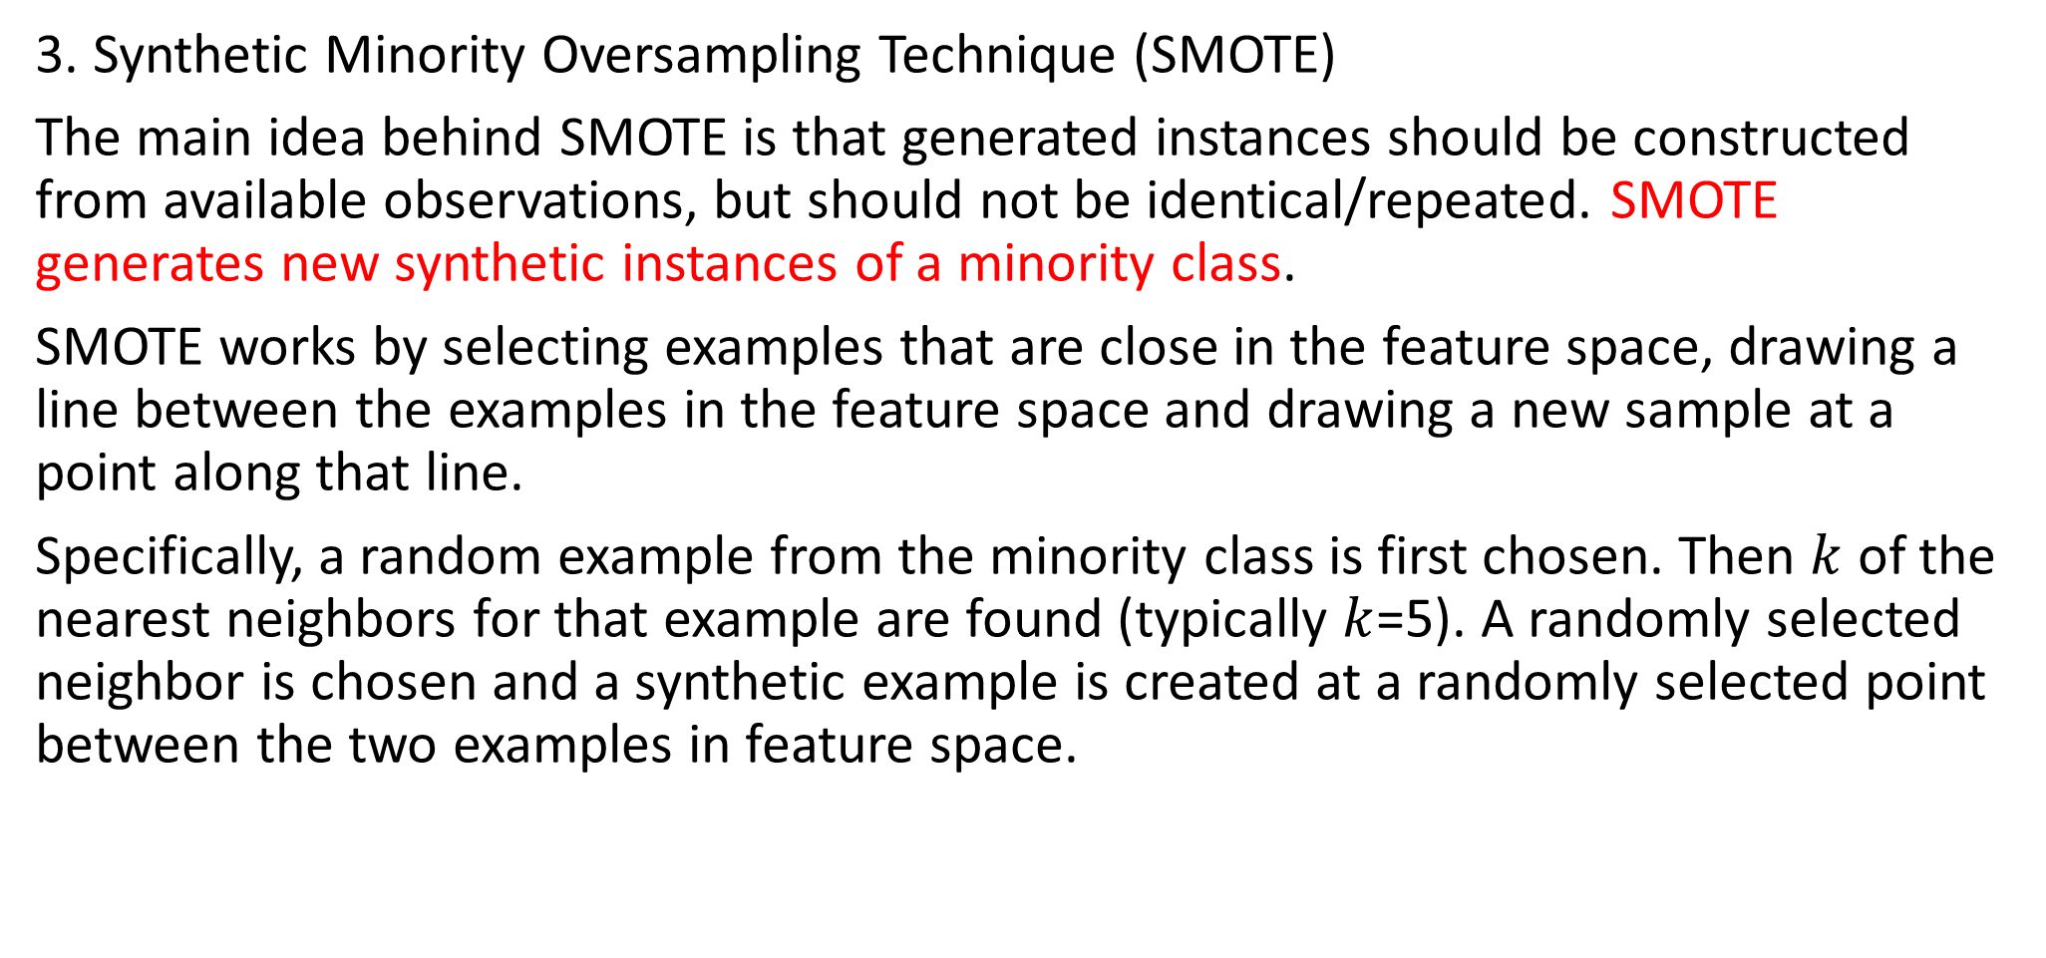
Tackle Imbalanced Datasets
3. Synthetic Minority Oversampling Technique (SMOTE)
The main idea behind SMOTE is that generated instances should be constructed from available observations, but should not be identical/repeated. SMOTE generates new synthetic instances of a minority class.
SMOTE works by selecting examples that are close in the feature space, drawing a line between the examples in the feature space and drawing a new sample at a point along that line.
Specifically, a random example from the minority class is first chosen. Then $k$ of the nearest neighbors for that example are found (typically $k$=5). A randomly selected neighbor is chosen and a synthetic example is created at a randomly selected point between the two examples in feature space.

Slide 13
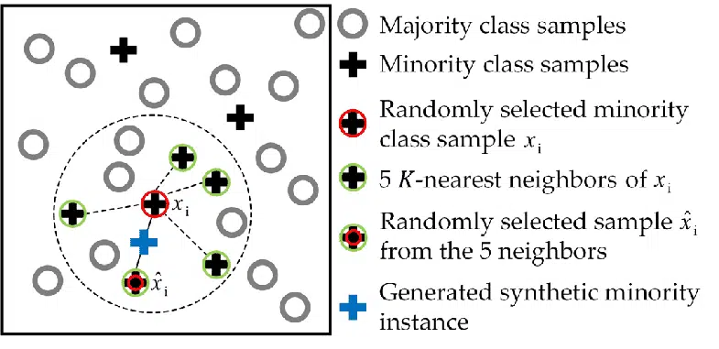
Tackle Imbalanced Datasets
Python libraries (imbalanced-learn).
from imblearn.over_sampling import SMOTE
# Resampling the minority class. The strategy can be changed as required.
sm = SMOTE(k_neighbors = 5, sampling_strategy='minority’)
X_train1, y_train1 = smote.fit_resample(X_train, y_train)
model=RandomForestClassifier()
model.fit(X_train1, y_train1)

Slide 14
Tackle Imbalanced Datasets
4. BorderlineSMOTE: BorderlineSMOTE is a variant of the SMOTE algorithm which makes the following assumption: “Instances closest to a decision boundary are more relevant.“
5. Adaptive Synthetic Sampling (ADASYN): Instead of focusing around a borderline decision region, ADASYN considers data density as the determining factor in identifying samples which are relevant to oversample. More synthetic data is generated where density of minority examples is low (and vice-versa).
6. Choose Proper Evaluation Metric: The accuracy of a classifier is the total number of correct predictions divided by the total number of predictions. This may be good enough for a well-balanced class but not ideal for an imbalanced class problem. Other metrics, such as precision measure how accurate the classifier’s prediction of a specific class, and recall measures the classifier’s ability to identify a class.
For an imbalanced class dataset, the F1 score is a more appropriate metric

